Slide 1
Lab Report On
Hotel Management System
Course Code: 3036 Section: 11
Course Name: Information System Design and Software Engineering
Presented By:
Group 6
Faria Sanjida Chowdhury
ID: 2017000000244
Moriom Hafsha Nuri
ID: 2017000000015
Kaniz Fatima
ID: 2016100000033
Sharin Maria
ID: 2017000000136
Pinki Roy
ID: 2016000000193

Slide 2
Introduction
Hotel Management System is a project which aims in developing a computerized system to maintain all the activities of a Hotel with the help of information system design. This project has been developed to help the guest as well as the staffs of a hotel to maintain the hotel in the best way possible.

Slide 3
Hotel Management System
SUBSYSTEMS
1. Reservation Management
Managing food or beverage orders
3. Bill Generation Management
Managing inventory status, product level, placing order, inventory update
Managing room booking, guest details, room status, arrival and departure date
2. Food Management
Generating bill for guests
4. Inventory Management
5. Report Management
Managing the reports of all departments

Slide 4
ACTORS
1. Guest
2. Receptionist
3. Service man
4. Inventory Manager
5. Supplier
6. Clerk
7. Manager
8. System

Slide 5
Use-Case Diagram

Slide 6
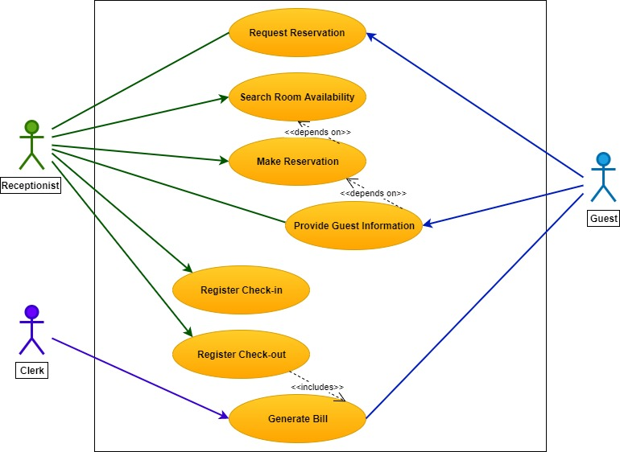
1. Reservation Management System
Reservation Management System

Slide 7
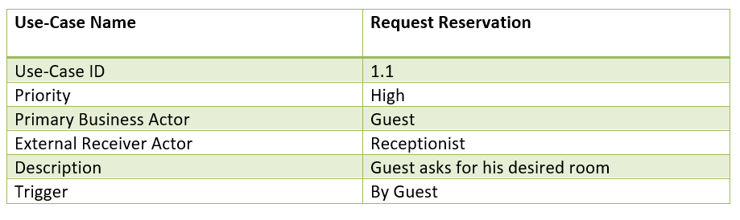
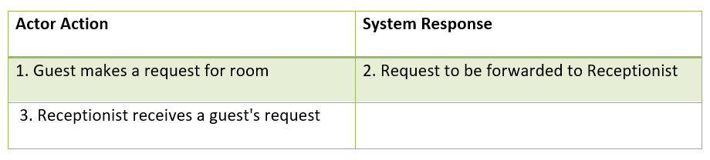
1.1 Request Reservation
1.1 Typical Course of Events

Slide 8
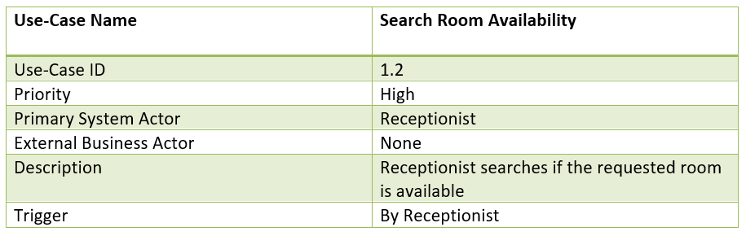
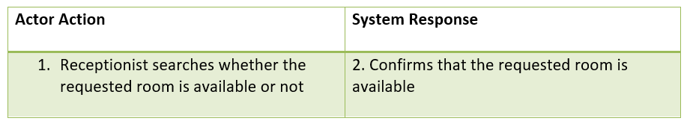
1.2 Search Room Availability
1.2 Typical Course of Events

Slide 9
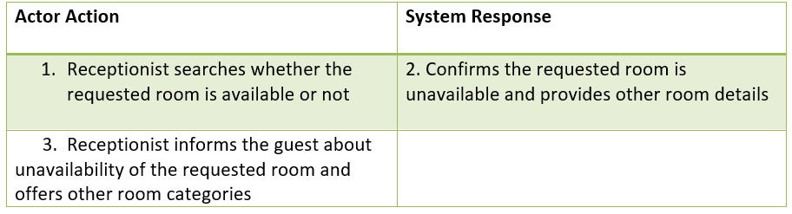
1.2 Alternate Course of Events

Slide 10
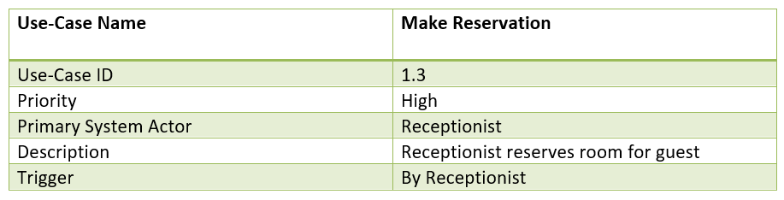
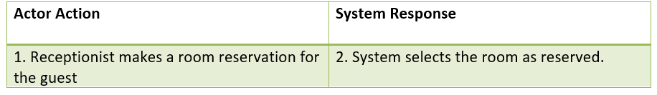
1.3 Make Reservation
1.3 Typical Course of Events

Slide 11
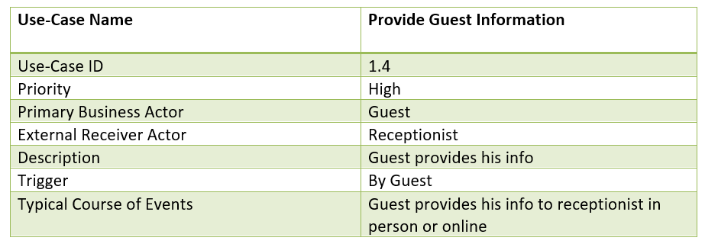
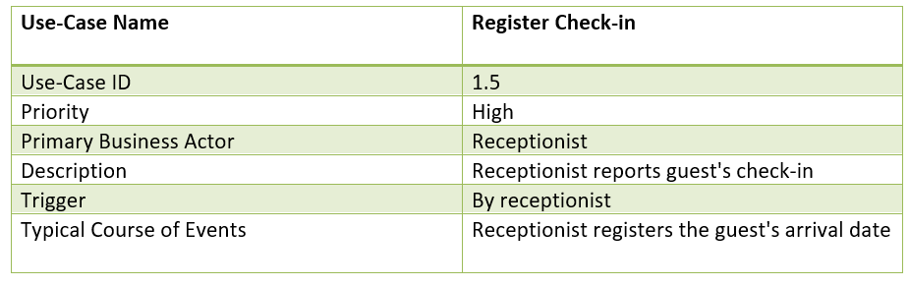
1.4 Provide Guest Information
1.5 Register Check-in

Slide 12
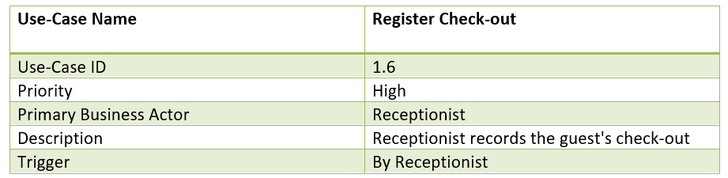
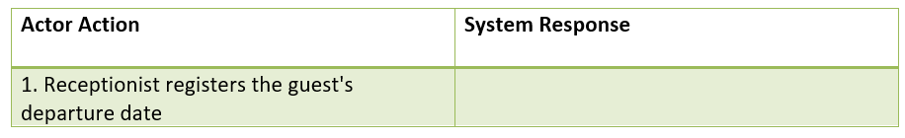
1.6 Register Check-out
1.6 Typical Course of Events

Slide 13
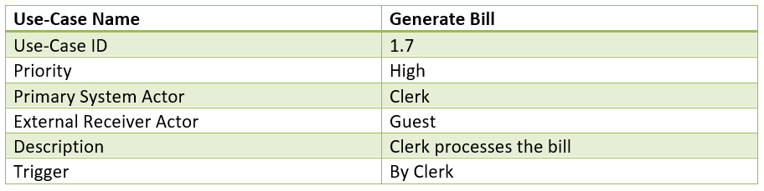
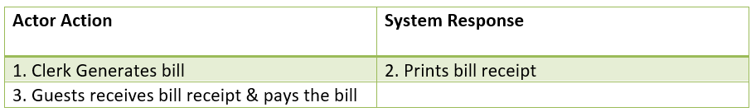
1.7 Generate Bill
1.7 Typical Course of Events

Slide 14
2. Food Management System
Use-case ID>Name | Description | Participant Actor
2.1>Get the placed order | Accept the specific ordered food from guest​ | Inventory manager, guest​
2.2>Check availability of inventory​ | According the guest order the manager checks the inventory​ | Inventory manager​
2.3>Accept the placed order​ | If the inventory's elements are present the manager accept the order​ | Inventory manager​
2.4>Serve the ordered food | Serve the desired food of the guest | Service person , guest
2.5>Generate the bill of ordered item's | Generate the bill of all item of food of the guest and give the bill to the guest | Clerk , guest

Slide 15
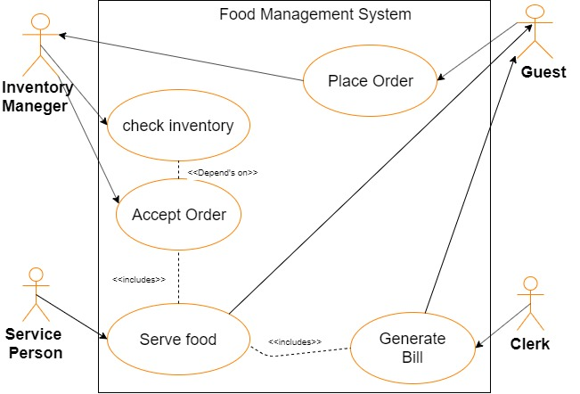

Slide 16
2.1:GET THE PLACED ORDER
Use-Case Name | Get Placed Order
Use-Case ID | 2.1
Priority | High
Primary Actor | Guest , Inventory Manager
Description | Guest placed order and the inventory manager get the order of guest
Trigger | Guest

Slide 17
2.1:TYPICAL COURSE OF EVENTS
Actor Action | System Action
1.Placed Order for the desire food | 3.Check the invetory for the respective oeder
2.Inventory Manager Get the order of guest

Slide 18
2.2:CHECK AVAILABILITY OF INVENTORY
Use-Cse Name | Check Availability Of Inventory
Use-Case ID | 2.2
Priority | High
Primary Actor | Inventory Manager
Description | After get the order of guest the inventory manager check the availability of the otder food
Trigger | Inventory Manager

Slide 19
2.2:TYPICAL COURSE OF EVENTS
Actor Action | System Action
1.The Inventory Manager Check the inventory According to the order of guest. | 2.present the inventory list are available .

Slide 20
2.3:ACCEPT THE PLACED ORDER
Use-Case Name | Accept The Placed Order
Use-Case ID | 2.3
Priority | High
Primary Actor | Inventory Manager
Description | Inventory Manager check the desire order of the guest and if available the manager acacept the order if not then the manager inform the guest.
Trigger | Inventory Manager

Slide 21
2.3:TYPICAL COURSE OF EVENTS
Actor Action | System ACtion
2.the inventory manager accept the order or cancel the order depends on the inventory list | 1.check the desire inventory of guest If available then inform the inventory manager and provide the list of the inventory

Slide 22
2.4:SERVE THE ORDERD FOOD
Use-Case Name | Serve The Orderd Food
Use-Case ID | 2.4
Priority | High
Primary Actor | Service Person
Description | The service man serve the orderd food to the guest
Trigger | Service man

Slide 23
2.4:TYPICAL COURSE OF EVENTS
Actor Action | System Action
1.Service manager serve the orderd food to the guest
2.The guest recive the food from the service man

Slide 24
2.5:GENERATE THE BILL
Use-Case Name | Generate The Bill
Use-Case ID | 2.5
Priority | High
Primary Actor | Clerk
Description | The clerk generate the bill of the guest and give the guest for pay the bill
Trigger | Clerk

Slide 25
2.5:TYPICAL COURSE OF EVENTS
Actor Action | System Action
2.Give the bill to the guest | 1.Generate the bill of guest
3.The guest ricive the bill

Slide 26
3. Bill Management System
Use-case ID>Name | Description | Participant Actor
3.1>collect the guest details. | Collect the whole details of the entered guest | Clerk
3.2>Generate bill of the guest. | Generates all the bills of each guest. | Clerk
3.3>pay all the bills | Guests pay’s all their bills. | Guest , Clerk
3.4>Records the report | Records all reports of all guest. | Clerk

Slide 27
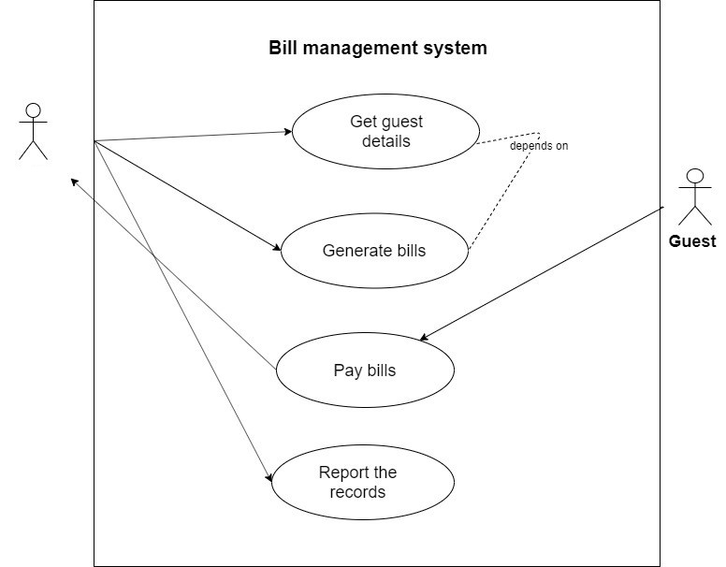
Clerk

Slide 28
3.1 Collect The Guest Details
Use-case Name | Collect The Guest Details
Use-case ID | 3.1
Priority | High
Description | Clerk collect the all information of the guest
Primary actor | clerk
Trigger | clerk

Slide 29
TYPICAL COURSE OF EVENTS
Actor Action | System Response
1.The clerk collect the guest details | 2.The system recorded the details

Slide 30
3.2 Generate Bill of the Guest.
Use-case Name | Generate Bill of the Guest
Use-case ID | 3.2
Priority | Heigh
Primary actor | clerk
Description | Generate bills of each guest give them.
Trigger | clerk

Slide 31
TYPICAL COURSE OF EVENTS
Actor Action | System Response
 | 1.Generate the bill for the guest
2.The clerk get the bills copy.

Slide 32
3.3 Pay All The Bills
Use-case Name | Pay All The Bills
Use-case ID | 3.3
Priority | Heigh
Primary actor | Clerk.guest
Description | Guest pay all the bills
Trigger | Guest

Slide 33
TYPICAL COURSE OF EVENTS
Actor Action | System Response
1.The clerk give the bills to the guest.
2.The guest receive the bill paper and pay the bill.
3.The clerk accept the payment.

Slide 34
3.4 Records The Report
Use-case Name | Records the report
Use-case ID | 3.4
Priority | Heigh
Primary actor | clerk
Description | Records all the report of all guest
Trigger | clerk

Slide 35
TYPICAL COURSE OF EVENTS
Actor Action | System Response
1.The clerk collect all the reports according the guests. | 2.Records all the reports..

Slide 36
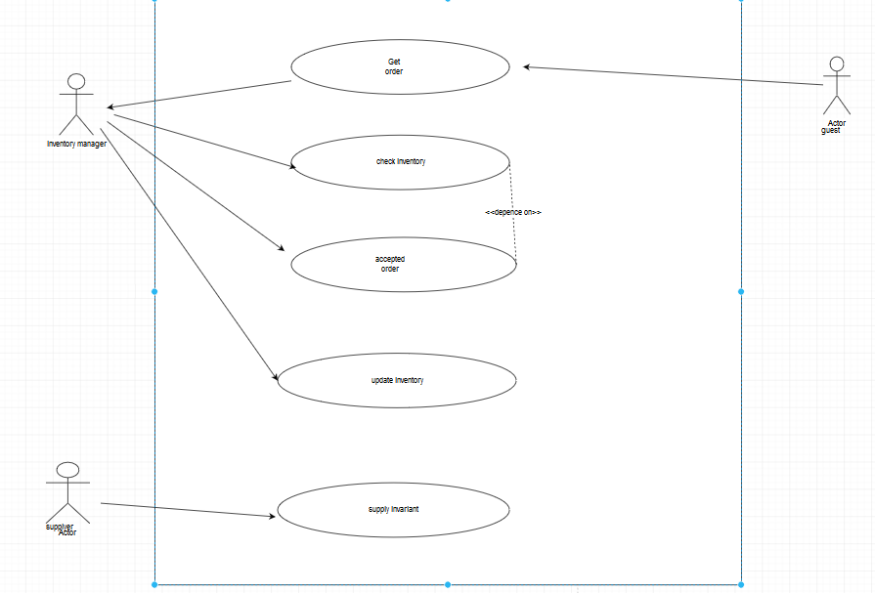
4. Inventory Management System

Slide 37
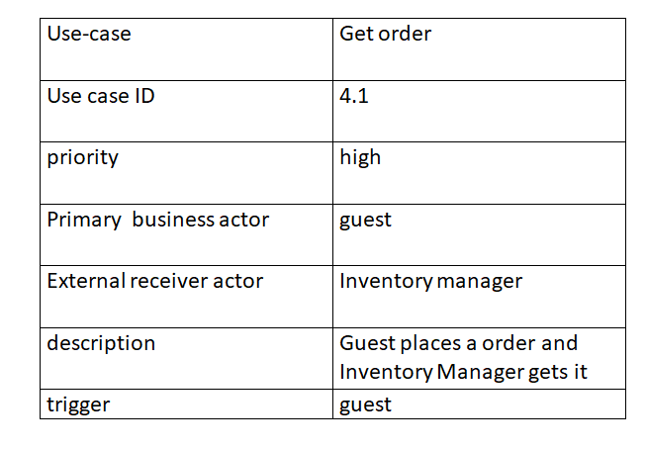
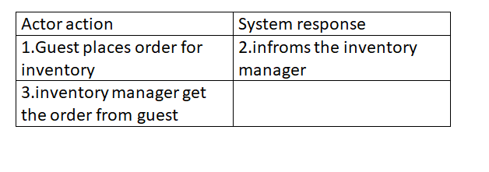
4.1 Get Order
4.1 Typical Course of Events

Slide 38
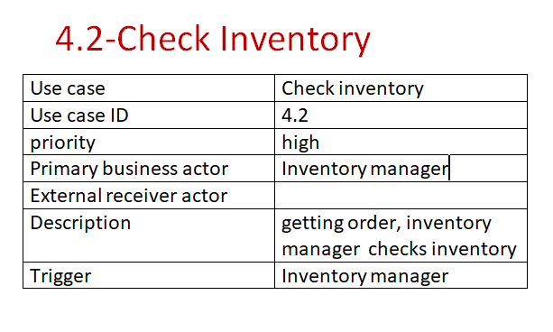
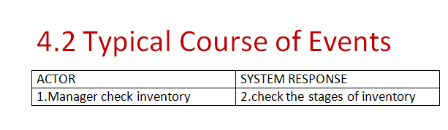

Slide 39
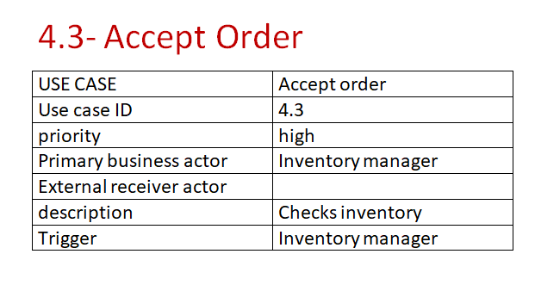
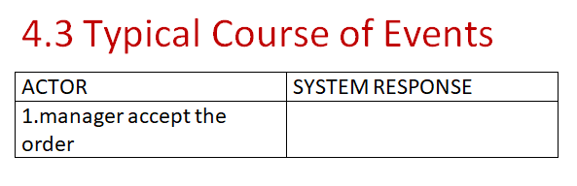

Slide 40
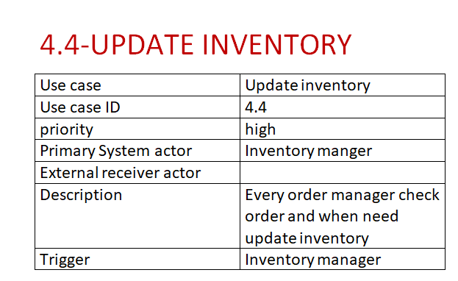
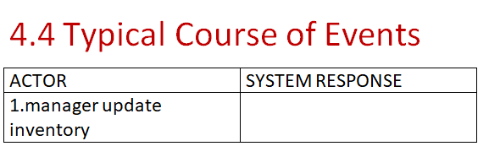

Slide 41
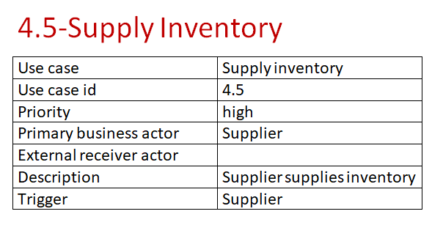
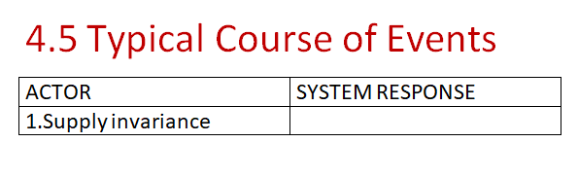

Slide 42
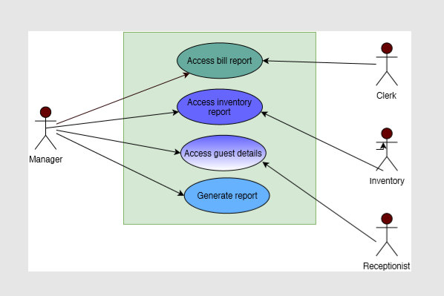
5. Report Management System

Slide 43
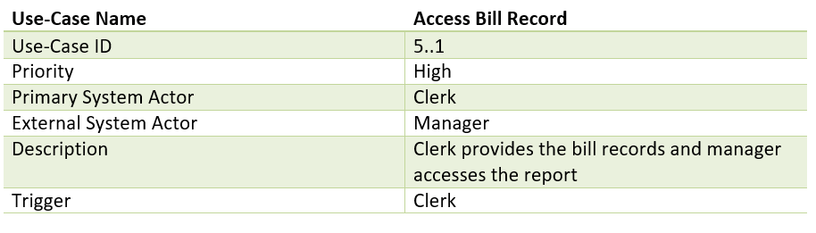
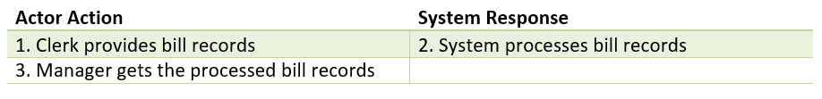

Slide 44
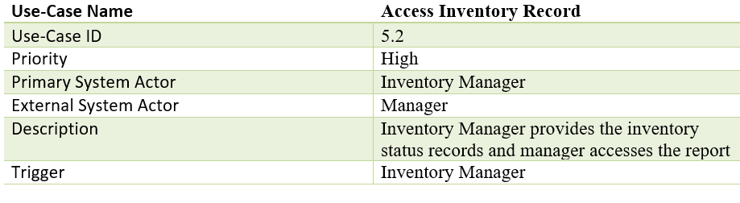
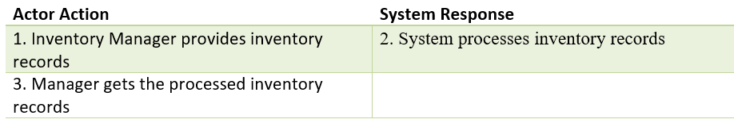

Slide 45
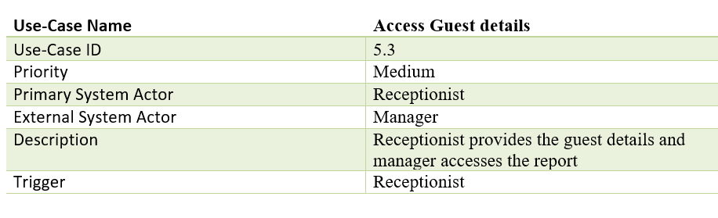
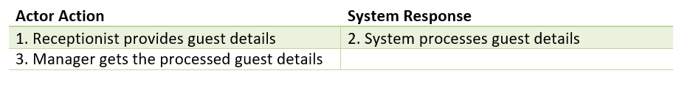

Slide 46
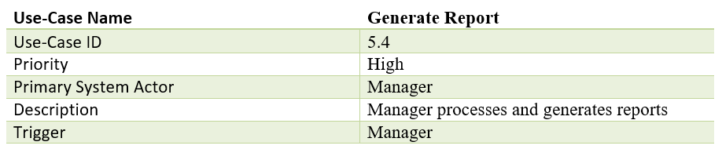
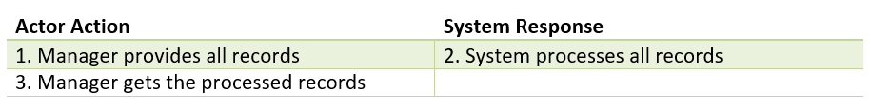

Slide 47
ACTIVITY DIAGRAM

Slide 48
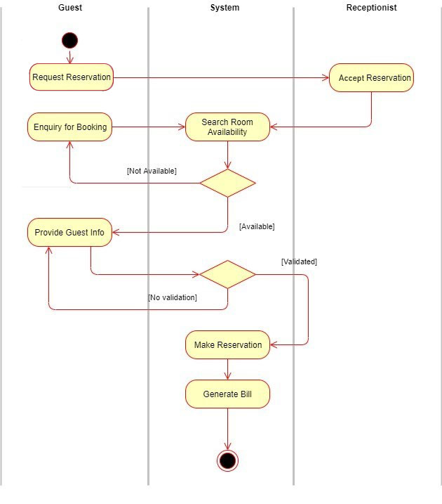
Fig 1: Activity Diagram for Reservation Management

Slide 49
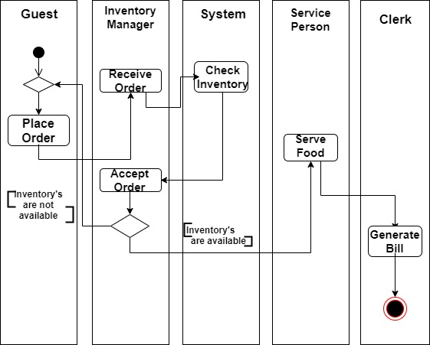
Fig 2: Activity Diagram for Food Management

Slide 50
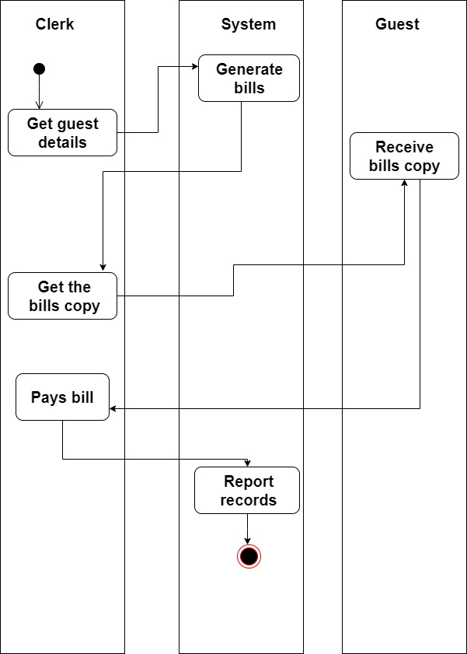
Fig 3: Activity Diagram for Bill Generation Management

Slide 51
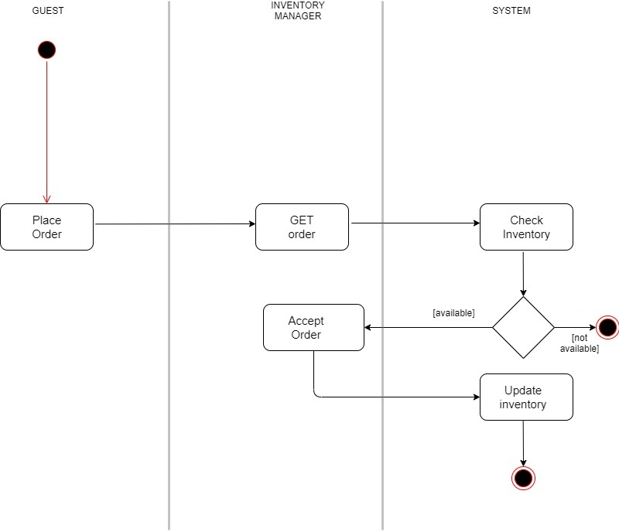
Fig 4: Activity Diagram for Inventory Management

Slide 52
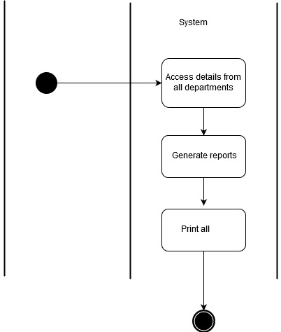
Fig 5: Activity Diagram for Report Management

Slide 53
DATA FLOW DIAGRAM

Slide 54
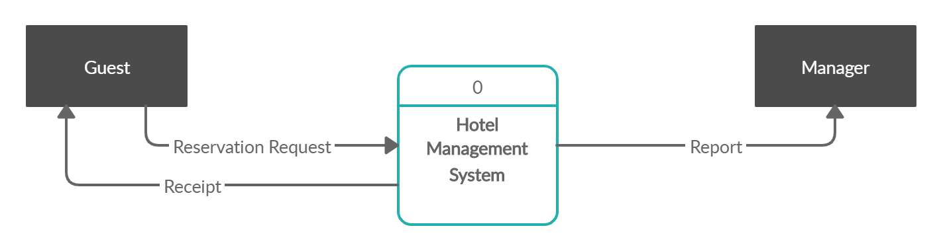
CONTEXT DIAGRAM

Slide 55
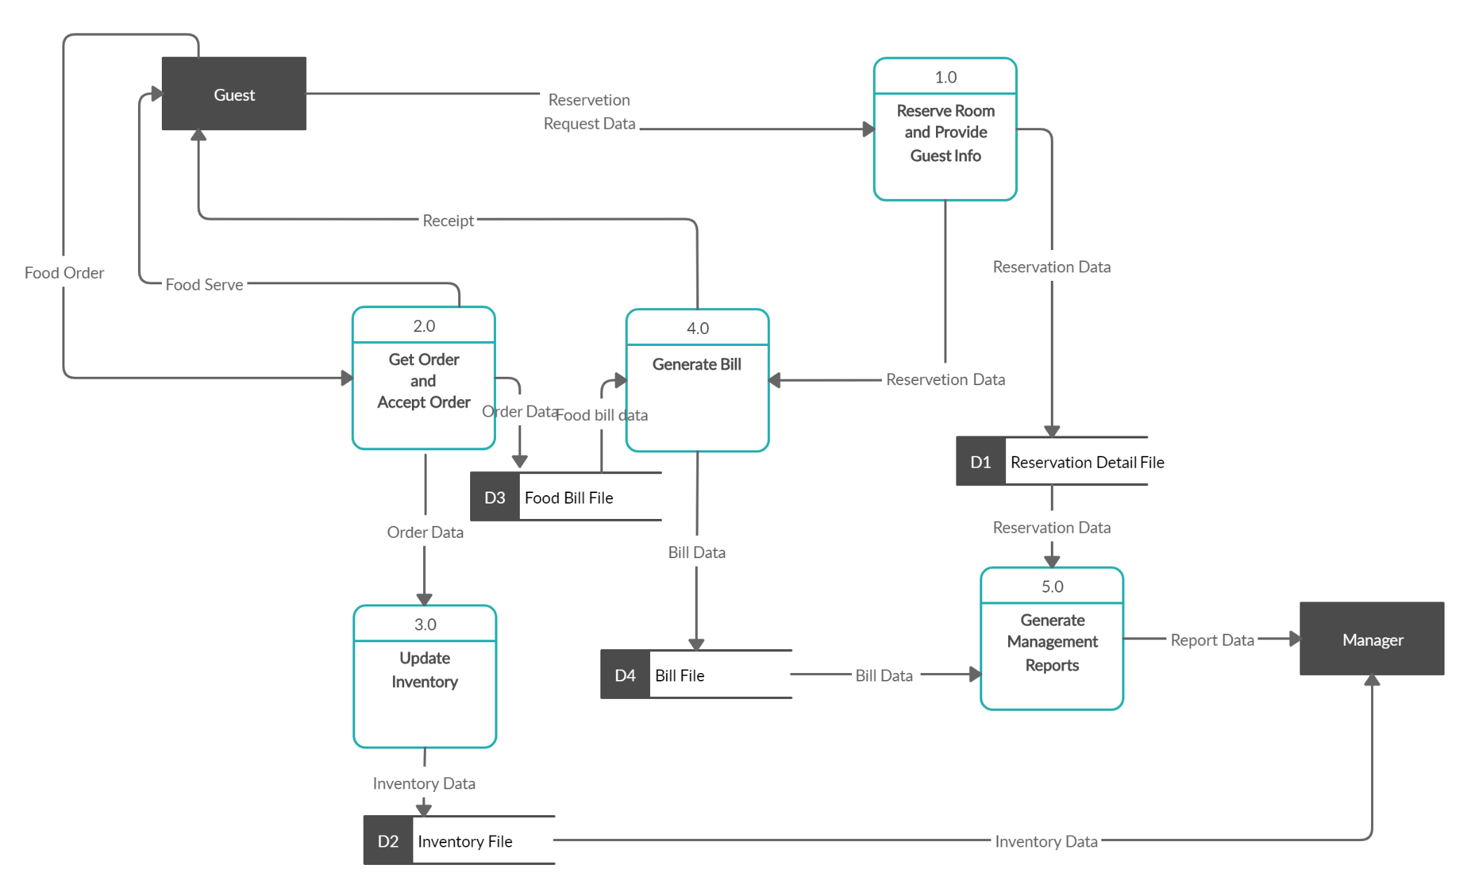
Level 0 DIAGRAM

Slide 56
LEVEL 1 DATA FLOW DIAGRAM FOR SUBSYSTEMS

Slide 57
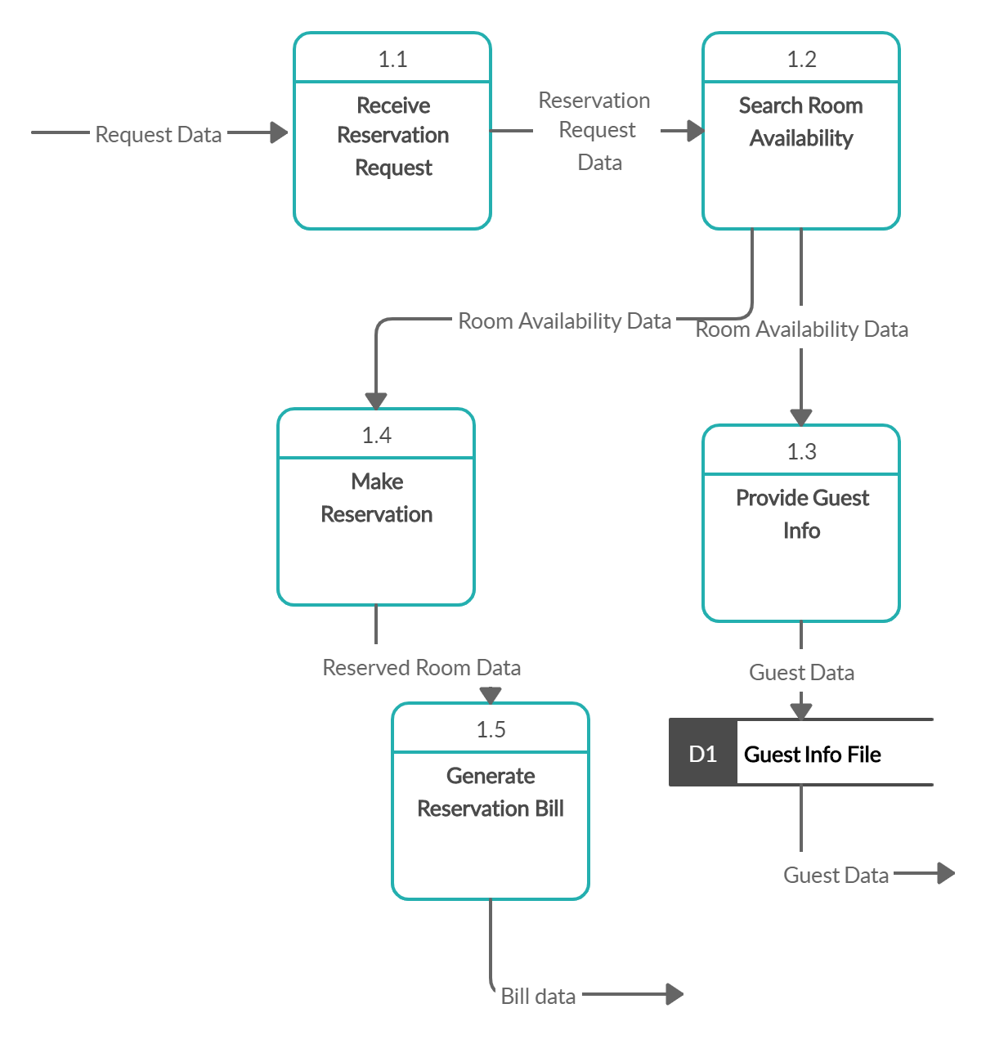
Fig 1: Level 1 DFD for Reservation Management

Slide 58
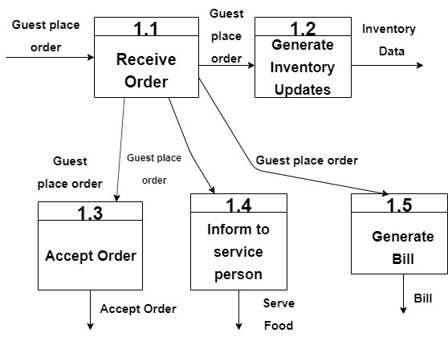
d
2.1
2.2
Data
2.4
2.5
2.3
Fig 2: Level 1 DFD for Food Management

Slide 59
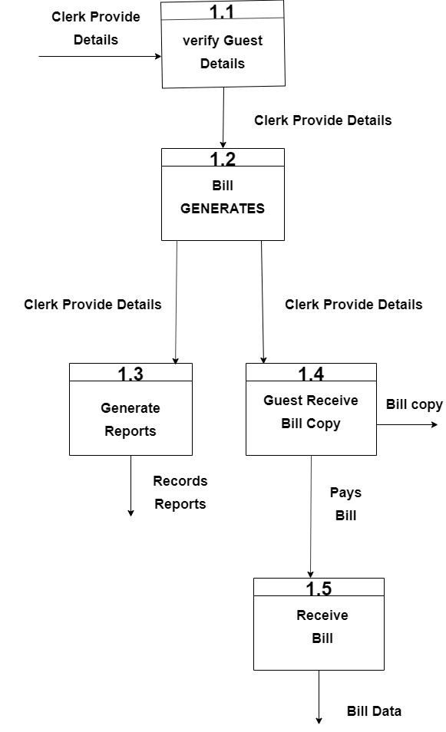
3.1
3.2
3.3
3.4
3.4
Receive
Bill
Fig 3: Level 1 DFD for Bill Generation Management

Slide 60
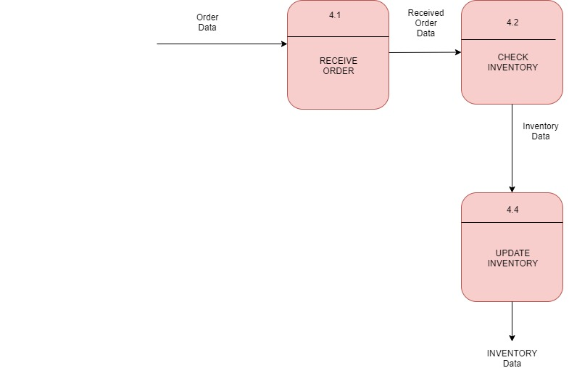
Fig 4: Level 1 DFD for Inventory Management

Slide 61
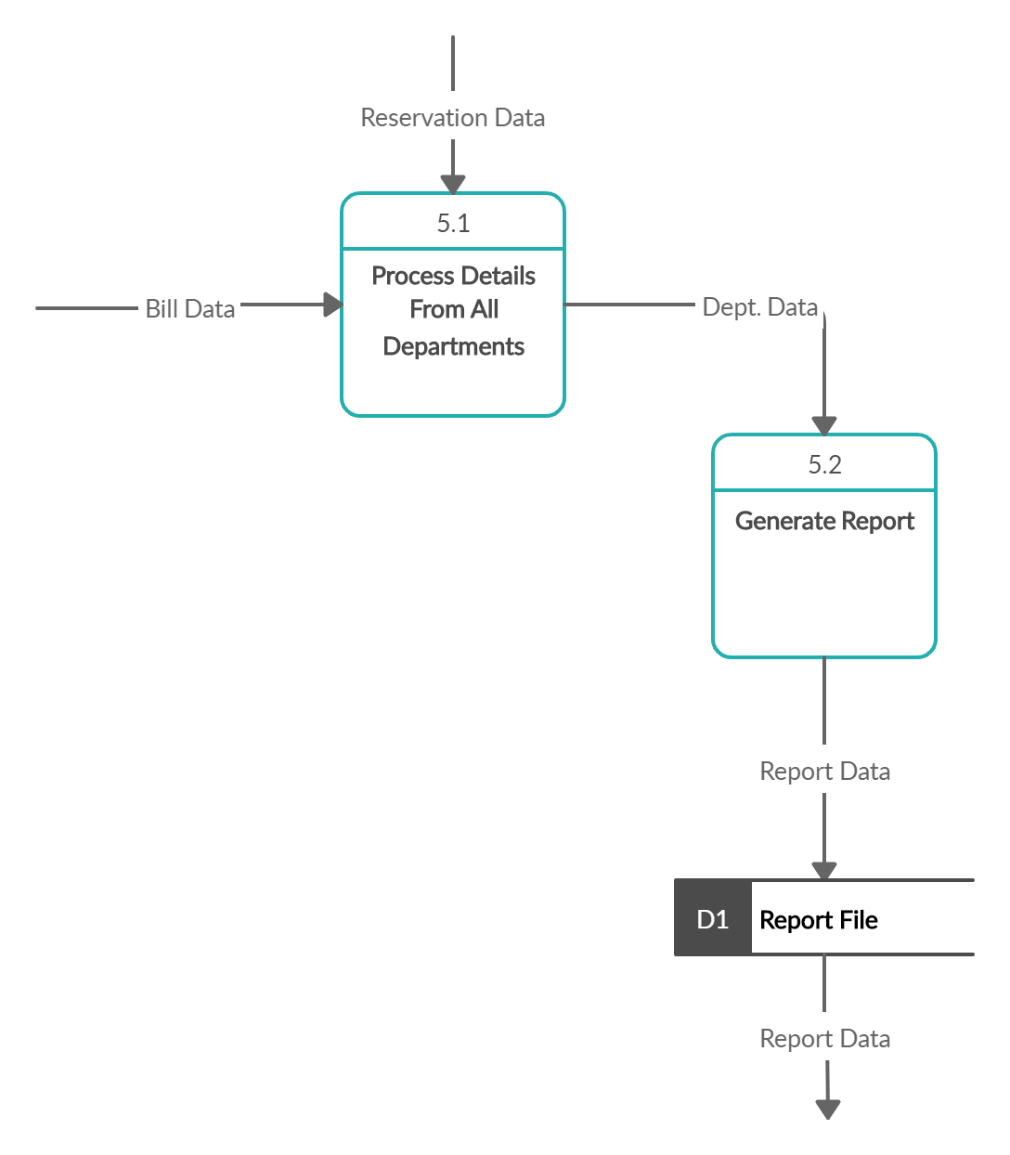
Fig 5: Level 1 DFD for Report Management

Slide 62
Class and Sequence Diagram

Slide 63
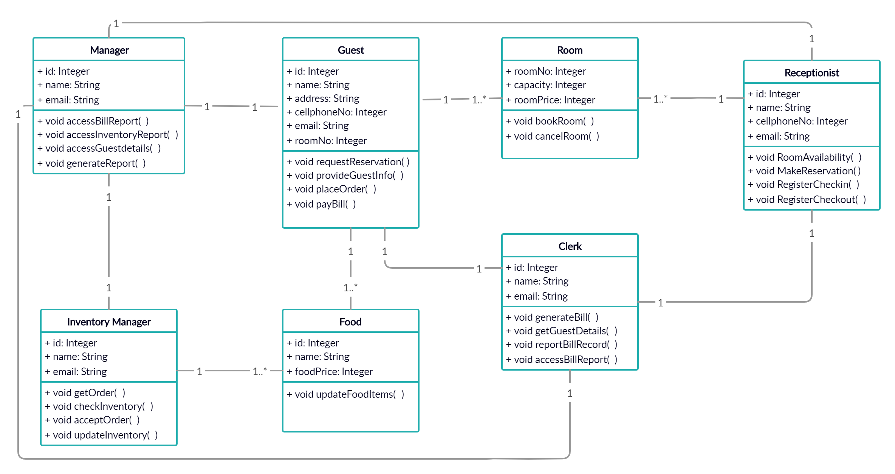
CLASS DIAGRAM

Slide 64
SEQUENCE DIAGRAM

Slide 65
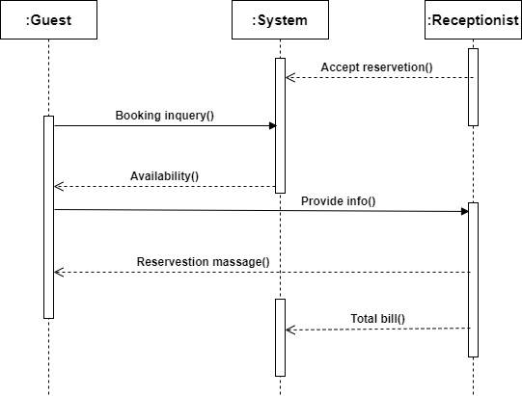
Fig 1: Sequence Diagram for Reservation Management

Slide 66

Fig 2: Sequence Diagram for Food Management

Slide 67

Fig 3: Sequence Diagram for Bill Generation Management

Slide 68

()
()
_ _ _ _ _ _ _ _ _ _ _ _
()
()
Fig 4: Sequence Diagram for Inventory Management

Slide 69

Fig 5: Sequence Diagram for Report Management

Slide 70
Learning Outcome
This helped us to understand Information System better and to learn implementing design in any system or any software field. It also taught us a working knowledge of concepts and terminology related to information technology and to analyze how a system works.
Future Plan
We can take help from this sample project to make our own new project or analyze our system afterwards.

Slide 71
END

